Slide 1
The Investigation of the Effectiveness of Urtica Dioica in the Streptozotocin-Induced Neurodegeneration Model Stj. Dr. Ebru Çiftkaya Doç. Dr. Birsen Elibol
Notes:
Hi everyone, welcome to my presentation. Im Ebru Çiftkaya fifth year medical student. Today ı would like to talk to you about my Project. Which name is

Slide 2
PLAN
Introduction
Material and method
Results
Discussion
References
Notes:
My presentation plan will progress in this order

Slide 3
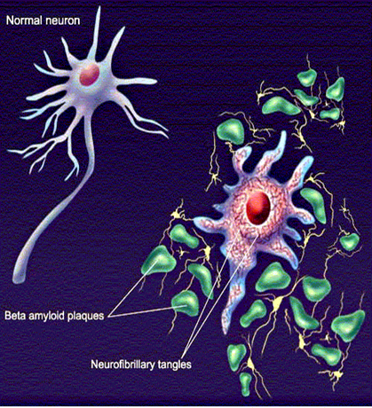
INTRODUCTION
Alzheimer’s Disease (AD):
Irreversible and progressive disorder.¹
The most common cause of dementia ²
Has no current cure, but treatments for symptoms are available and researchs continue. ²
1. Morley JE, Farr SA, Nguyen AD. Alzheimer Disease. Clinics in Geriatric Medicine. 2018.
2.Weller J, Budson A. Current understanding of Alzheimer’s disease diagnosis and treatment. F1000Research. 2018.
Notes:
- Briefly , Alzheimer’s Disease (AD) is an irreversible and progressive disorder that affects more than 40 million of people around the World. This disease is the most common cause of dementia. Patient’s symptom is in early stages, memory loss is mild, but with late-stage Alzheimer's, individuals lose the ability to carry on a conversation and respond to their environment. Alzheimer's is the sixth leading cause of death in the United States.

Slide 4
INTRODUCTION
Due to the lack of a permanent cure of AD, the researches for neuroprotective phytotherapeutics for preventing AD-related neuronal damage has gained momentum.

Slide 5
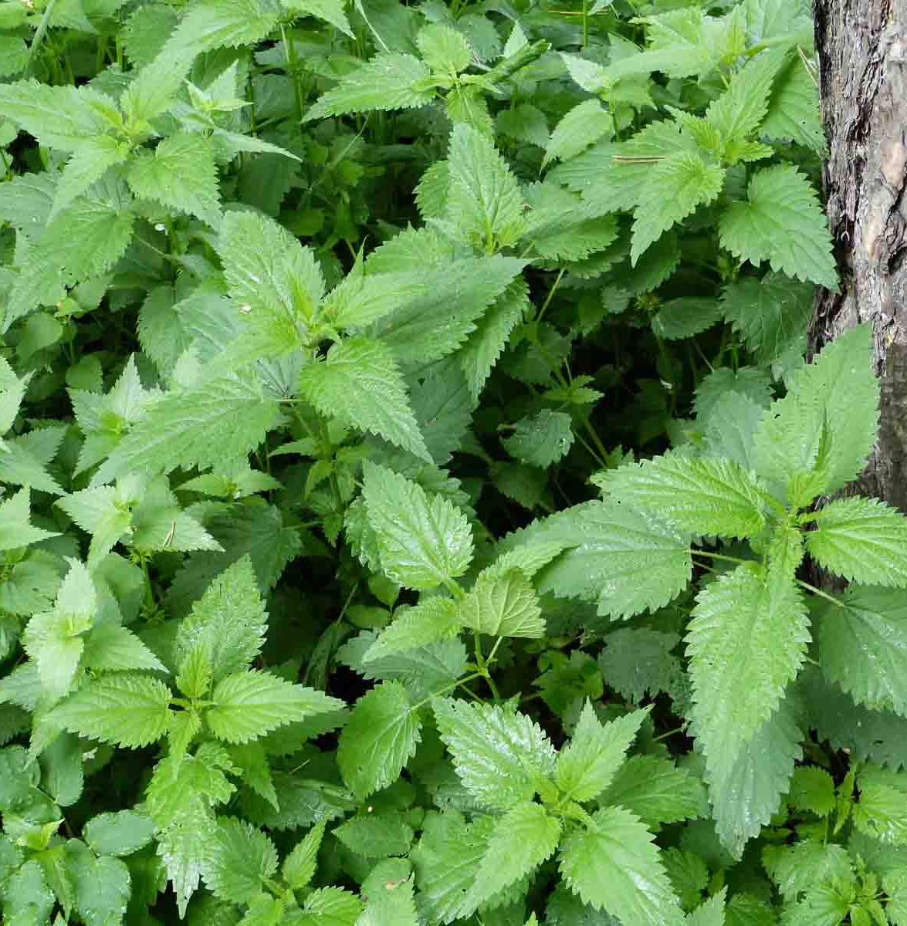
INTRODUCTION
U. dioica is the most common species of the Urticaceae family commonly known as Stinging nettle and one of the most studied medicinal plants worldwide. ³
3.Upton, R. Stinging nettles leaf (Urtica dioica L.): Extraordinary vegetable medicine. J. Herb. Med. 2013, 3, 9–38.
Notes:
So we decided to use Urtica dioica which is known as stining nettle as you can see in this picture

Slide 6
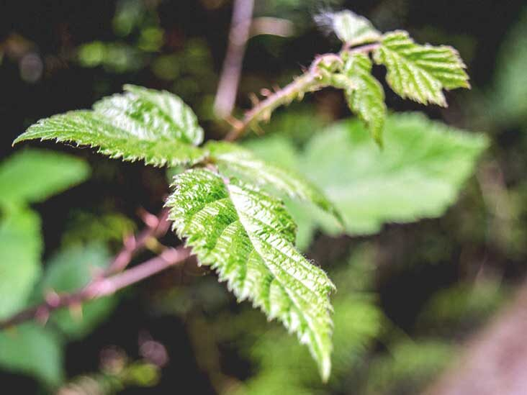
INTRODUCTION
Protective effect on diabetic neuropathy by reducing hyperglycemia ⁴
Memory-improving effect on the hippocampus.⁴
AD is known as type 3 diyabetes mellitus. ⁵
4.Patel SS, Gupta S, Udayabanu M. Urtica dioica modulates hippocampal insulin signaling and recognition memory deficit in streptozotocin induced diabetic mice. Metab Brain Dis. 2016;31(3):601–11.
5. De La Monte SM, Wands JR. Alzheimer’s disease is type 3 diabetes-evidence reviewed. Vol. 2, Journal of Diabetes Science and Technology. 2008. p. 1101–13.
Notes:
tHe reason why we choose UD that
The previous studies showed that UD has a protective effect on diabetic neuropathy by reducing hyperglycemia and has a memory-improving effect on the hippocampus.⁴
AD is known as type 3 diyabetes mellitus. ⁵
Therefore, we aimed to investigate the effects of UD on the hippocampus of streptozotocin (STZ) induced-rats.

Slide 7
MATERIAL and METHOD
Adult female Long Evans rats (6 months old) obtained from Bezmialem Vakif University animal laboratory were used in this study. (n=29)
Group 1
CONTROL
n=5
Group 2
SHAM
n=8
Artifical CSF
Group 3
STZ
n=8
İcv, bilaterally
3 mg/kg
Group 4
n=8
STZ+UD
icv, bilaterally
3 mg/kg
6 months later
UD-50 mg/kg/day
for 4 weeks
Notes:
In the present study, we used 6 months old female long evans rat. The rats were divided into 4 groups;
first group is control group no treatment was applied.
The rats in second group were given artificial intracerebrospinal fluid. The rats in the third group got intracerebroventricularly (i.c.v.) 3 mg/kg STZ injections within a stereotactic frame.
The rats in the fourth group got UD orally at the dose of 50 mg/kg/day for 4 weeks after STZ injection

Slide 8
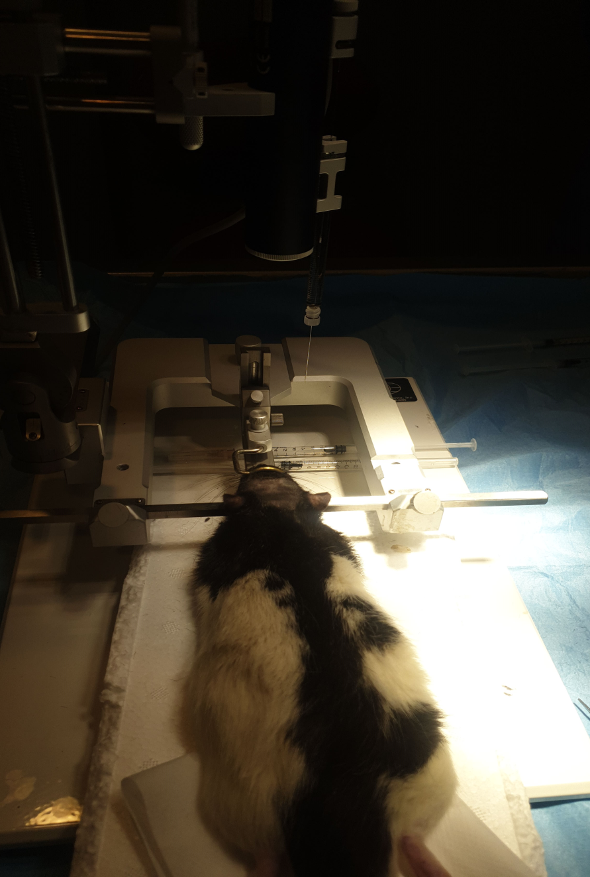
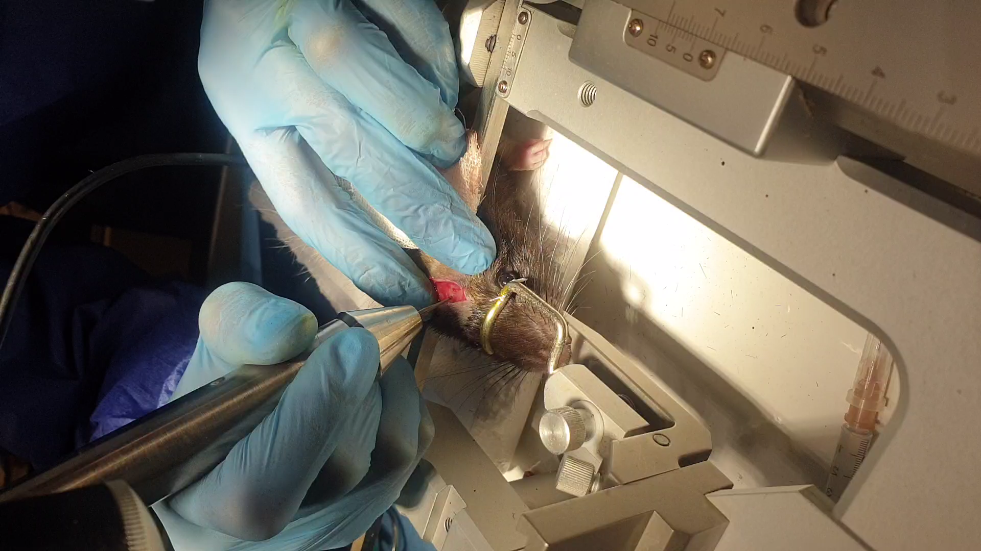
MATERIAL and METHOD
By adjusting the coordinates with stereotaxy, it was injected into the space between both ventricles.
0.8 mm posterior and 1.5 mm lateral and 3.5 mm depth from bregma
Notes:
As you can see stz injection was given to the interventricular space according to the coordinates in the stereotaxic rat brain atlas

Slide 9
MATERIAL and METHOD
At the end of 4 weeks, Morris Water Maze (MWM) was applied for cognitive functions.
After behavioral experiments, histologically; Cresyl violet and Congo red staining were performed.
The hippocampal tissue of animals were investigated to determine the changes in the proteins related to AD pathology (PSEN, pTau, Amyloid beta, BACE, and reelin) and functioning of hippocampal tissue (nNOS, brevican, CAMKII, prealbumin, and NMDR).

Slide 10
RESULTS
UD treatment attenuated the STZ-induced learning deficiencies in the MWM training.
Notes:
when we come to the results, firstly I want to tell morris water maze experiment which measures the learning abilities. We put the rats to the water-filled pool. As you may know its quiet interesting that rats don’t like swimming they tried to find hidden platform as soon as possible and we measured the time it took to find the hidden platform for 6 days

Slide 11
RESULTS
One-way ANOVA performed for each training day confirmed significantly worse performance in STZ group compared with control groups on the third and the sixth training days.
Notes:
in this experiment measuring learning capacity, when we look at the figure, control group painted in blue. There was a decrease day by day n the time to find the platform. In stz group which is in the gray painted, especially worsening 3 and 6 days significantly. UD group compared to stz group we can see improvement in the learning

Slide 12
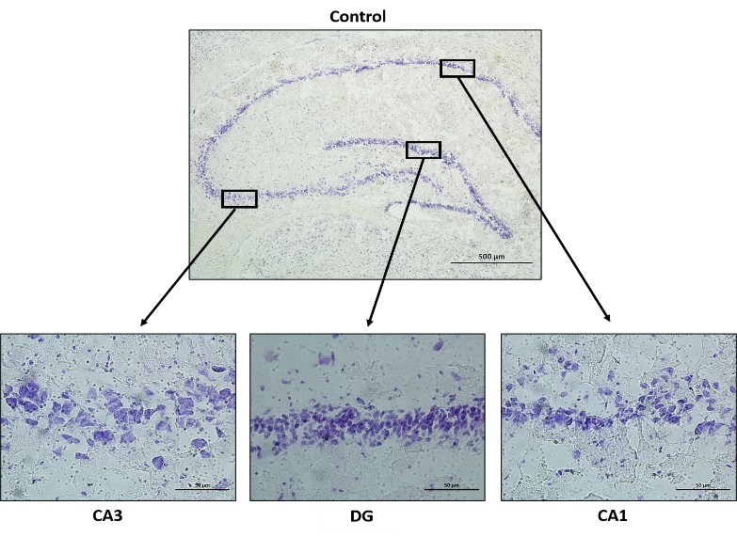
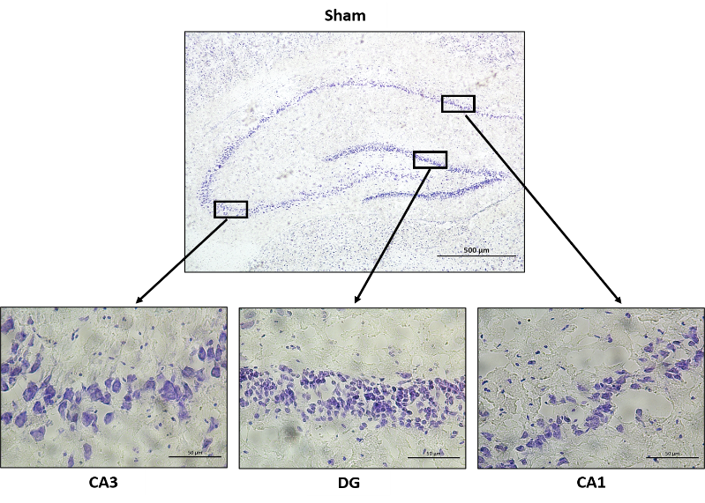
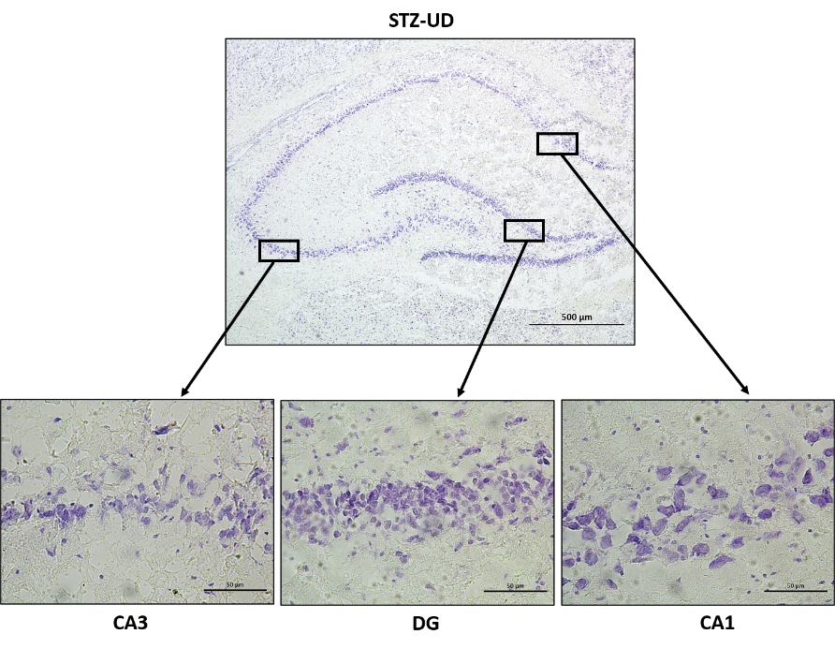
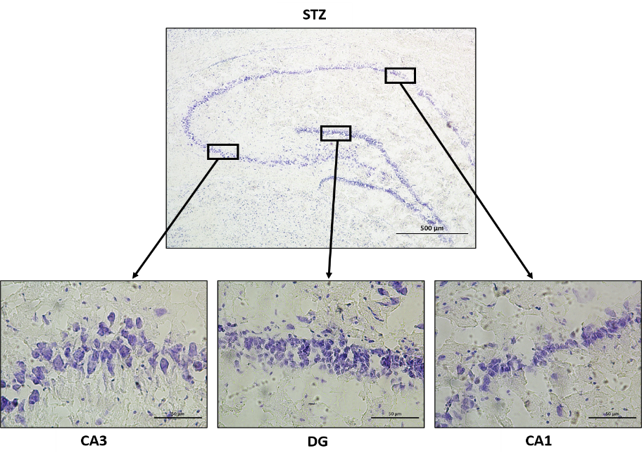
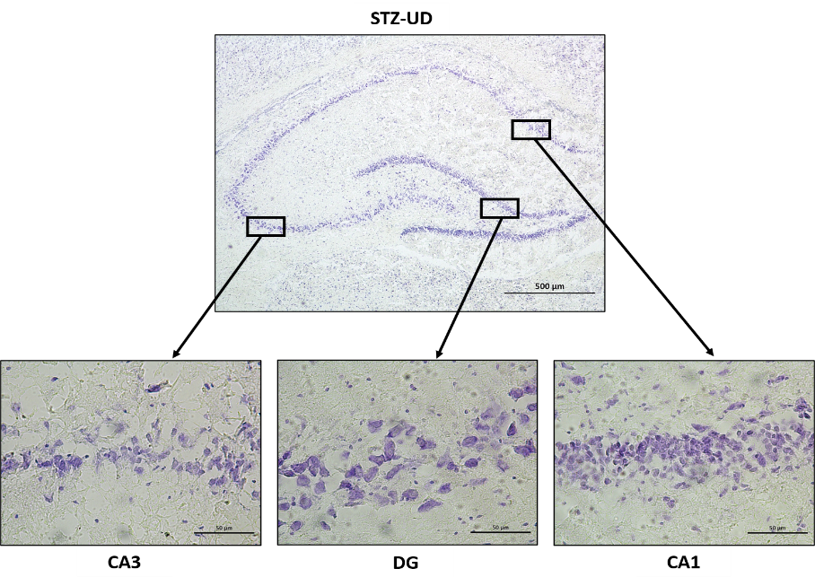
RESULTS
Notes:
After the behavioral experiments were finished, we sacrificed the animals. Firstly histologicallyy we did cresy violet staining for analyzing viable pyramidal neurons from hippocampal regions

Slide 13
RESULTS
Cresyl Violet staining performed for analyzing viable pyramidal neurons from hippocampal regions showed that STZ injection lower the number of neurons in the hippocampus.
UD treatment had a positive impact on the number of viable neurons in the hippocampus.

Slide 14
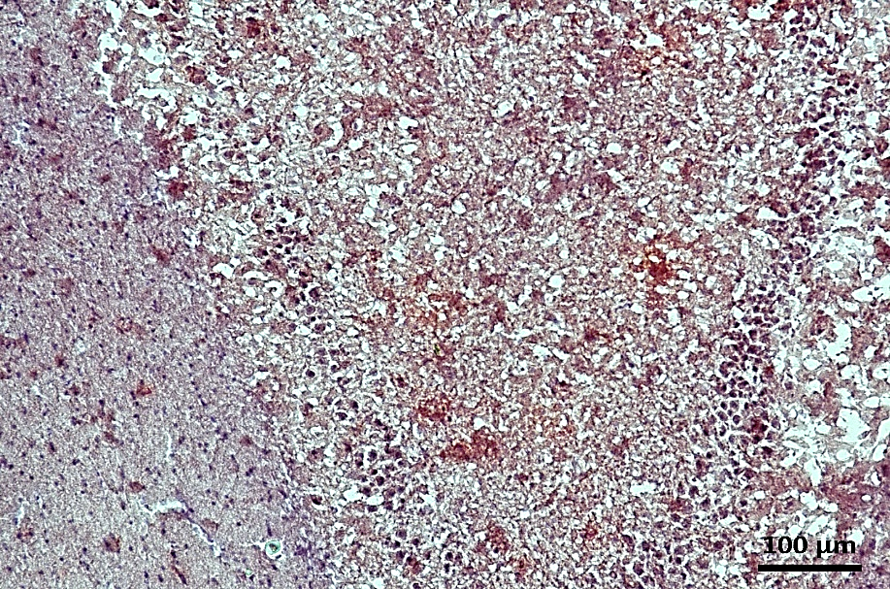
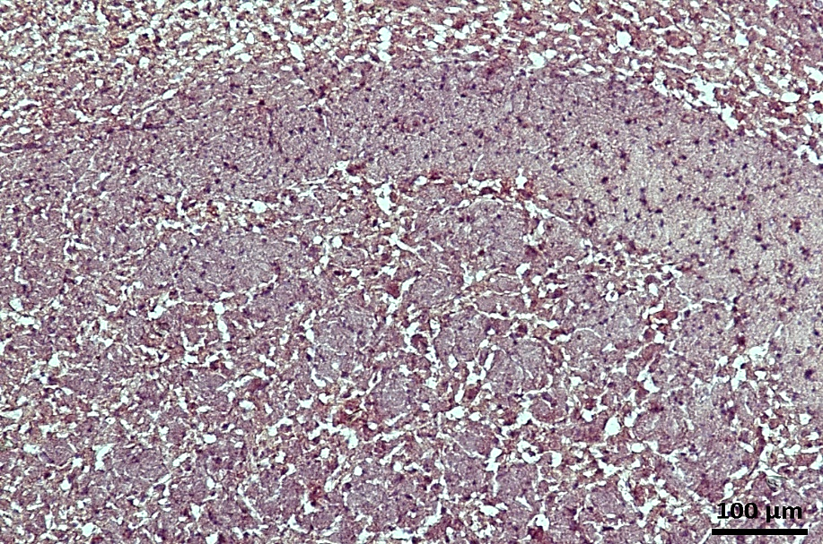
RESULTS
STZ
STZ-UD
Urtica Dioica reduced number of the Aβ plaques in Alzheimer's disease model
Notes:
As you can see Kongo red staining which shows ab plaques, Urtica Dioica reduced number of the Aβ plaques in Alzheimer's disease model.

Slide 15
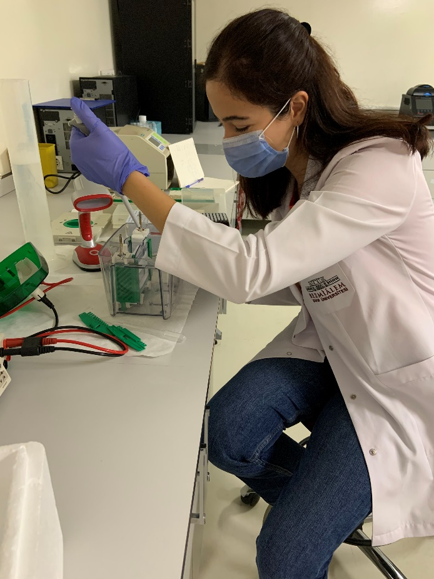
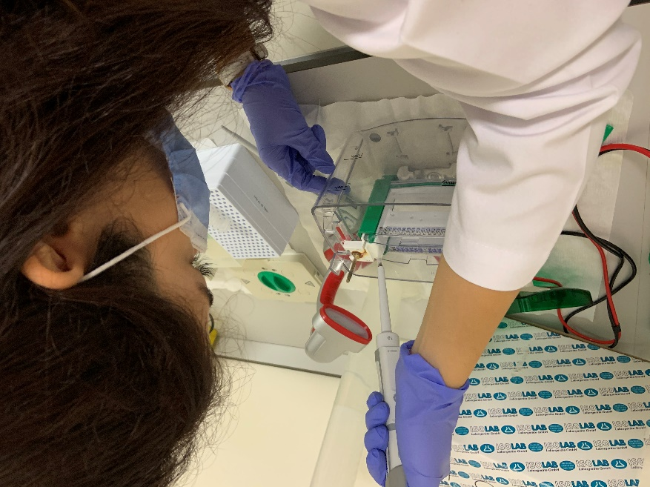
RESULTS
WESTERN BLOT
Notes:
If we look at the results of the studies at the molecular level, we did western blot analysis

Slide 16
RESULTS
Control
CSF
STZ
STZ-UD
At the molecular analysis, compared to the control groups, STZ injection increased the amount of BACE which are ameliorated by the UD treatment.
Notes:
BACE is involved in the pathogenesis of Alzheimer's. An increase which was observed in the AD group improved by UD treatment

Slide 17
RESULTS
NMDR and CAMKII proteins, which are involved in learning and memory, were significantly decreased in STZ group and increased in the treatment group.
Notes:
UD improved the learning function depressed by STZ induced.

Slide 18
RESULTS
Brevican, is involved in the increase of new signal pathways. Increase was observed in the treatment group.
nNOS, which is expected to increase in AD, was found to decrease with treatment.

Slide 19
DISCUSSION
Urtica Dioica achieved an improvement in the level of impaired learning and declining neurons in the Alzheimer's disease model.
The BACE level, which increased with Alzheimer's disease, decreased to normal in rats receiving Urtica Dioica.
Urtica Dioica reduced number of the Aβ plaques in Alzheimer's disease model.

Slide 20
Limitation:
STZ does not fully cover Alzheimer’s model, it occurs a neurodegeneration model, if there will be an item will fully satify or using transgenic model.
Strength:
There was not enough work on this subject at the molecular level

Slide 21
DISCUSSION
These results show that; Urtica Dioica has the potential to be a candidate phytotherapeutic molecule in improving cognitive functions impaired by Alzheimer's disease.

Slide 22
REFERENCES
1. Weller J, Budson A. Current understanding of Alzheimer’s disease diagnosis and treatment. F1000Research. 2018.
2. Morley JE, Farr SA, Nguyen AD. Alzheimer Disease. Clinics in Geriatric Medicine. 2018.
3. Upton, R. Stinging nettles leaf (Urtica dioica L.): Extraordinary vegetable medicine. J. Herb. Med. 2013, 3, 9–38.
4. Patel SS, Gupta S, Udayabanu M. Urtica dioica modulates hippocampal insulin signaling and recognition memory deficit in streptozotocin induced diabetic mice. Metab Brain Dis. 2016;31(3):601–11.
5. De La Monte SM, Wands JR. Alzheimer’s disease is type 3 diabetes-evidence reviewed. Vol. 2, Journal of Diabetes Science and Technology. 2008. p. 1101–13.
6.E. Grunblatt, M. Salkovic-Petrisic, J. Osmanovic, P. Riederer, S. HoyerBrain insulin system dysfunction in streptozotocin intracerebroventricularly treated rats generates hyperphosphorylated tau protein, J. Neurochem., 101 (2007), pp. 757-770,
7.Akter K, Lanza EA, Martin SA, Myronyuk N, Rua M, Raffa RB. Diabetes mellitus and Alzheimer’s disease: Shared pathology and treatment? Br J Clin Pharmacol. 2011;
8. Patel SS, Udayabanu M. Urtica dioica extract attenuates depressive like behavior and associative memory dysfunction in dexamethasone induced diabetic mice. Metab Brain Dis. 2014;29(1):121–30.
9.Bnouham M, Merhfour FZ, Ziyyat A, Mekhfi H, Aziz M, Legssyer A. Antihyperglycemic activity of the aqueous extract of Urtica dioica. Fitoterapia. 2003;74(7–8):677–81

Slide 23
Notes:
Thank you for listening to me if ı had a mistake sorry for that ı hope you understand my Project thank you again!!

